Slide 1
CARMA SIMULATION sprint Review
Sprint Review - SIM 2023-08
Simulation (VOICES, XIL, & HDSArch) Teams
6/21/2023

Slide 2
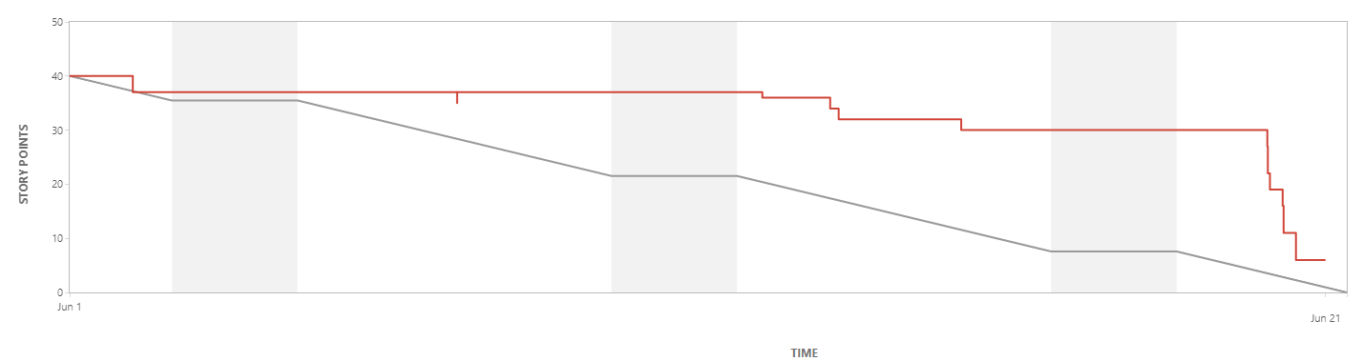
Sprint Overview – SIM 2023-08
Sprint Goal: K900 Release of XiL; Common interface outline, pilot test reporting; Design capture exercise complete for HDSA.
Assigned Story Points: 40
Completed: 34 Not Started: 0 (6 In-Progress)
Notes:
Sim -> Robin

Slide 3
VOICES
Notes:
Voices -> Robin

Slide 4
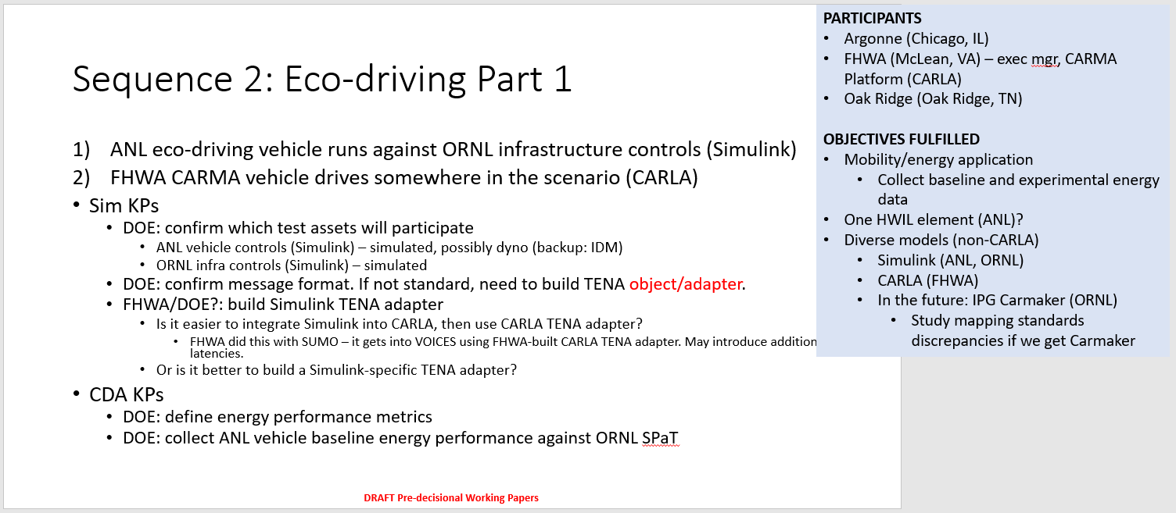
Voices pilot 2 planning
Notes:
Robin

Slide 5
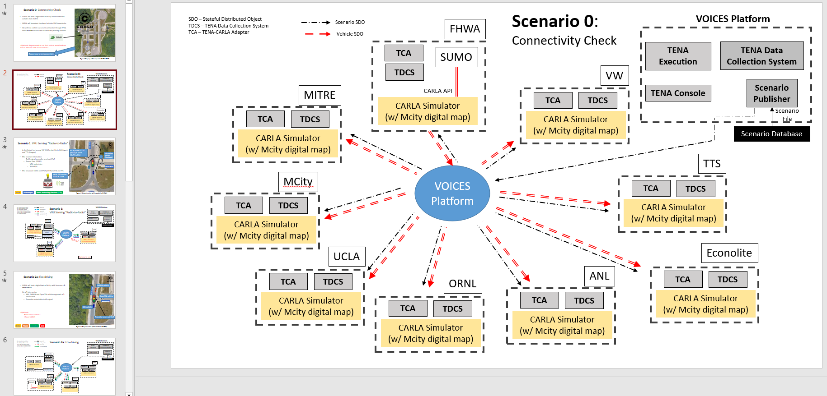
Voices pilot 2 planning
Notes:
Robin -> Aamil

Slide 6
VOI-59/60 Requirements and ICD for Common Interface
Finished Common Interface ICD
Found out basic requirements need from Carla to common interface
Determined what Carla needs as inputs to run
set up virtual environment to code common interface
Goals for next sprint :
Finish developing skeleton for common interface
develop common interface, and have it so that we have it where all of Carla information sits, and we can UDP packet it and send it over
Investigate more in depth of how we send back that data, what platform to use:
Simulink?
Notes:
Aamil

Slide 7
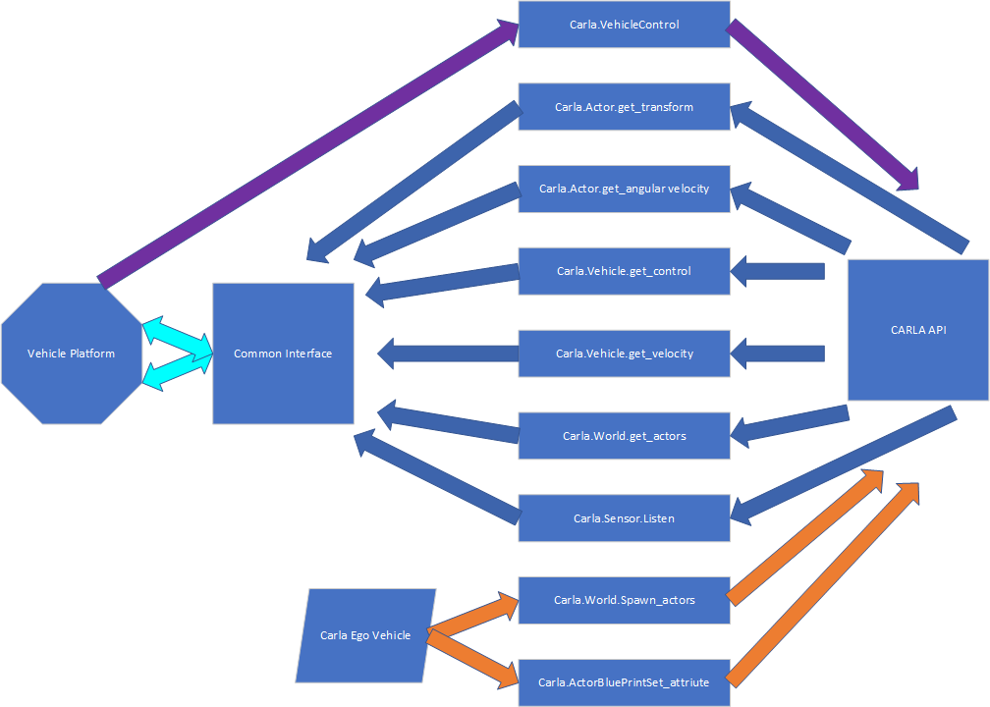
Common interface layout
Notes:
Aamil -> XiL

Slide 8
XIL
Notes:
XiL -> Verification

Slide 9
XiL-382: Verification Testing With CARMA Streets/V2XHub
Paul, Cheng, Eric, Saina, Kyle all had “Support Verification” stories.
Verification was led by testing team, supported by Abey and Mae.
Notes:
Verification -> Eric

Slide 10
Xil-537 Support Verification
Test case | Description | Pass/Fail
XIL1 | CARMA Platform Ego Vehicle Registration | Pass
XIL2 | CARMA Platform Input Dataflows | Pass
XIL3 | CARMA Platform Output Dataflows | Fail
XIL4 | CARMA Platform V2X Messaging | Pass
XIL5 | CARMA Platform Time Synchronization | Fail
XIL6 | CARMA Streets Input Dataflows | Pass

Slide 11
Xil-537 Support Verification
Test case | Description | Pass/Fail
XIL7 | CARMA Streets Output Dataflows | Pass
XIL8 | CARMA Streets Time Synchronization | Pass
XIL9 | V2XHub V2X Communications Dataflows | Pass
XIL10 | V2XHub Time Synchronization | Pass
XIL11 | Infrastructure Registration | Pass
XIL12 | Full System Test | Pass

Slide 12
Xil-537 Support Verificaiton
Issue | Github
Unusual acceleration value | https://github.com/usdot-fhwa-stol/carma-platform/issues/2117
Command frequency unexplained variation | https://github.com/usdot-fhwa-stol/carma-platform/issues/2118
CARLA initialization causes semi-random time offset​ | https://github.com/usdot-fhwa-stol/carma-platform/issues/2119

Slide 13
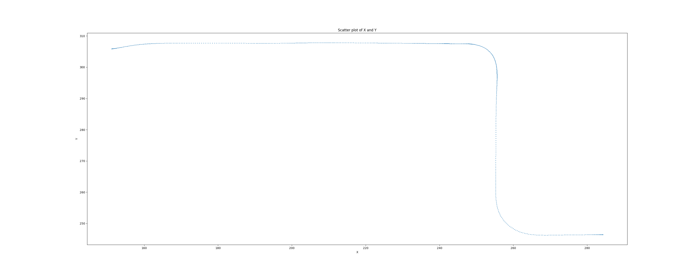
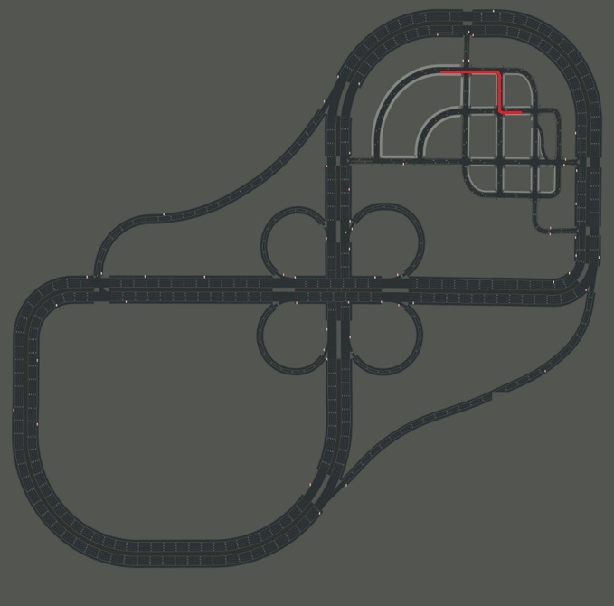
Support verification
Notes:
Cheng

Slide 14
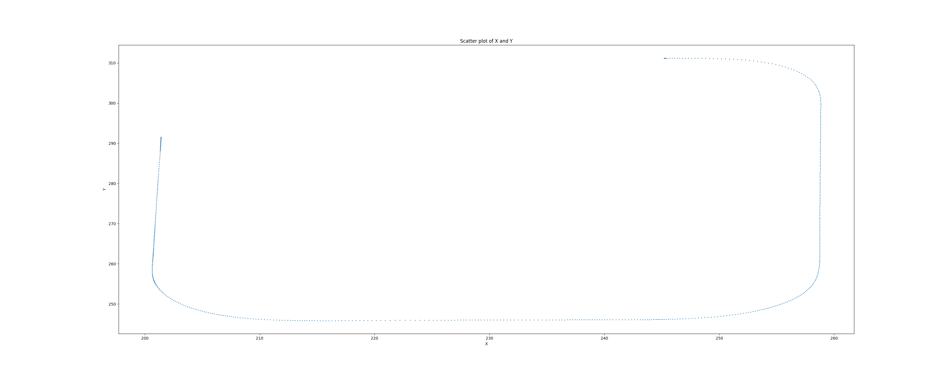
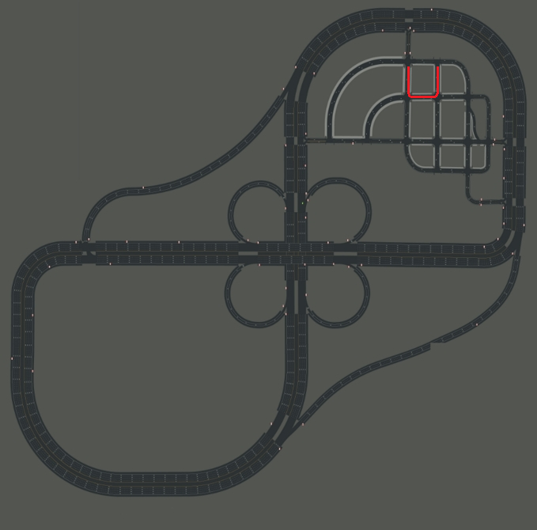
Support verification
Notes:
Cheng

Slide 15
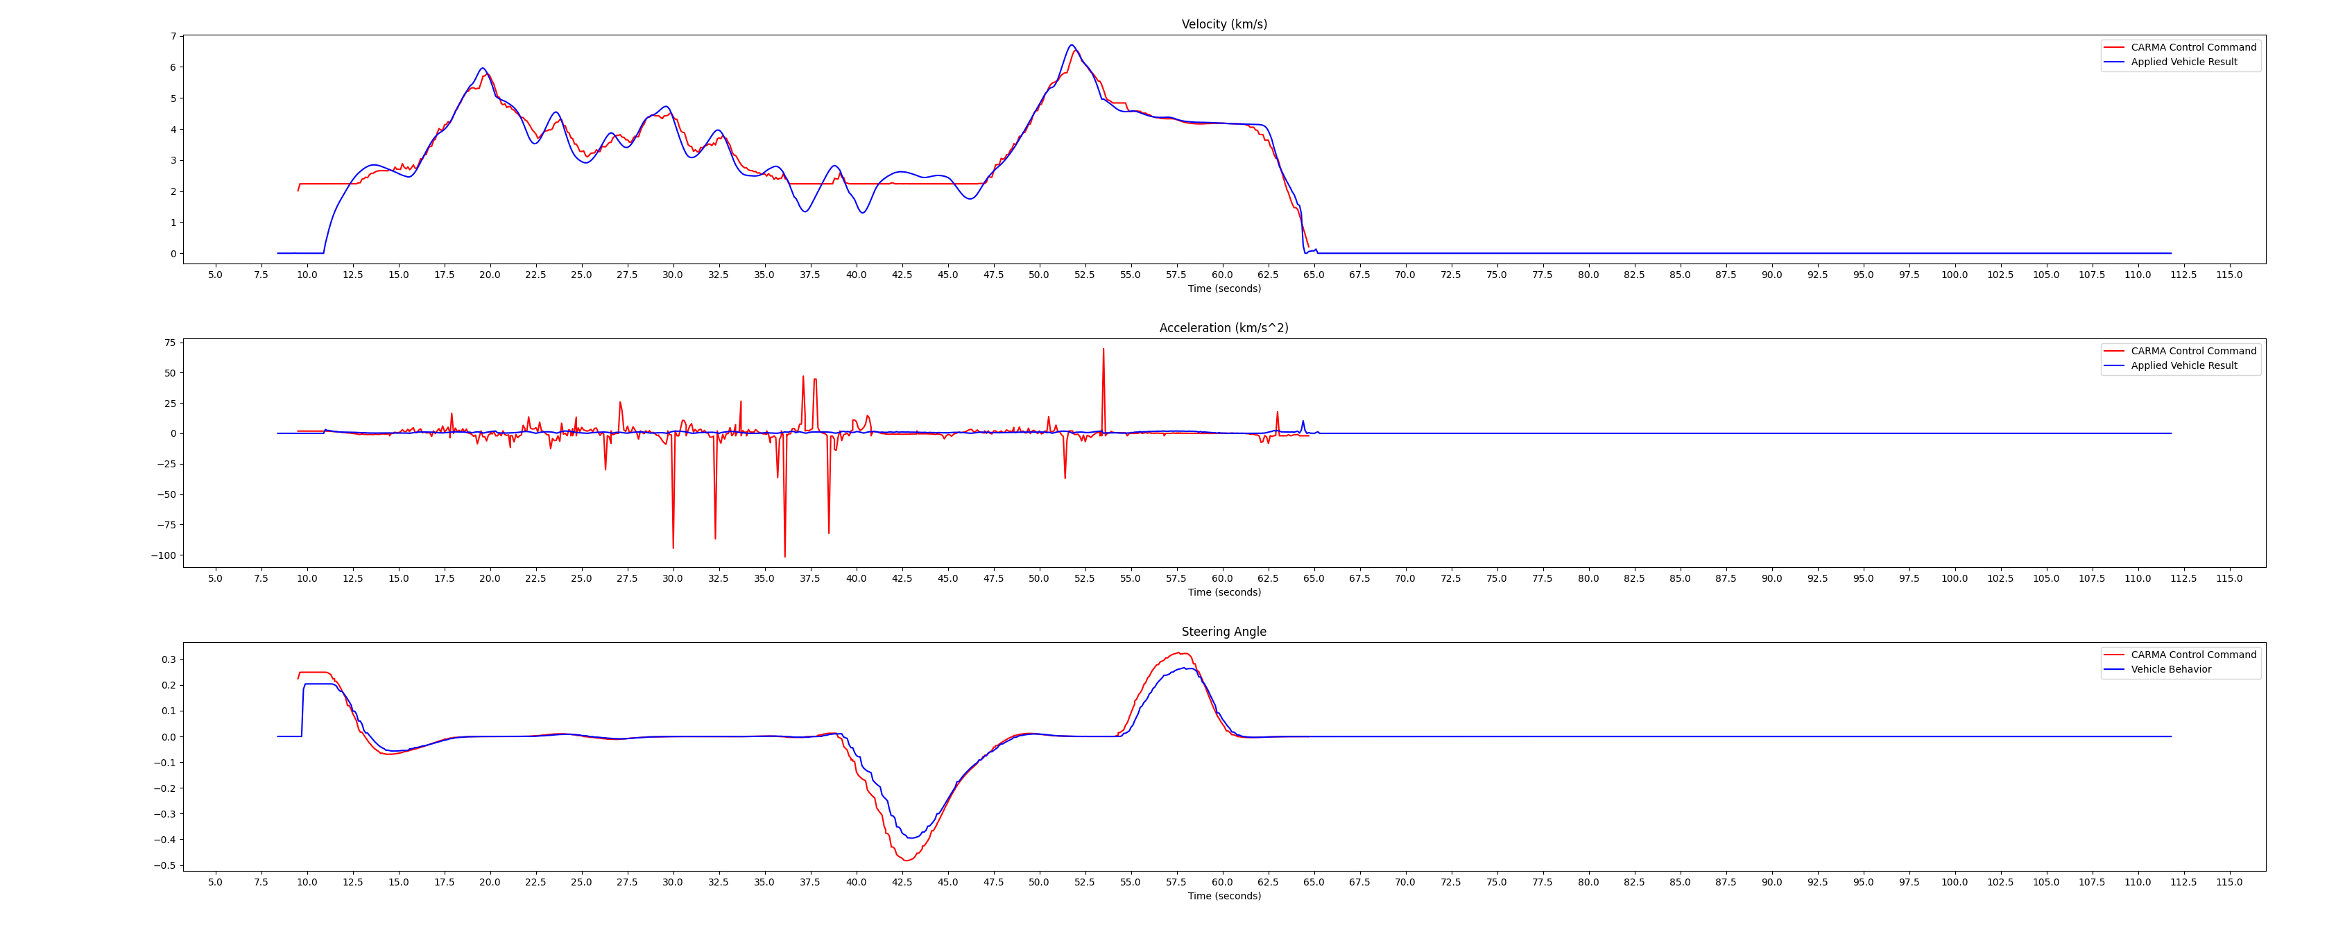
Support verification
Notes:
Cheng

Slide 16
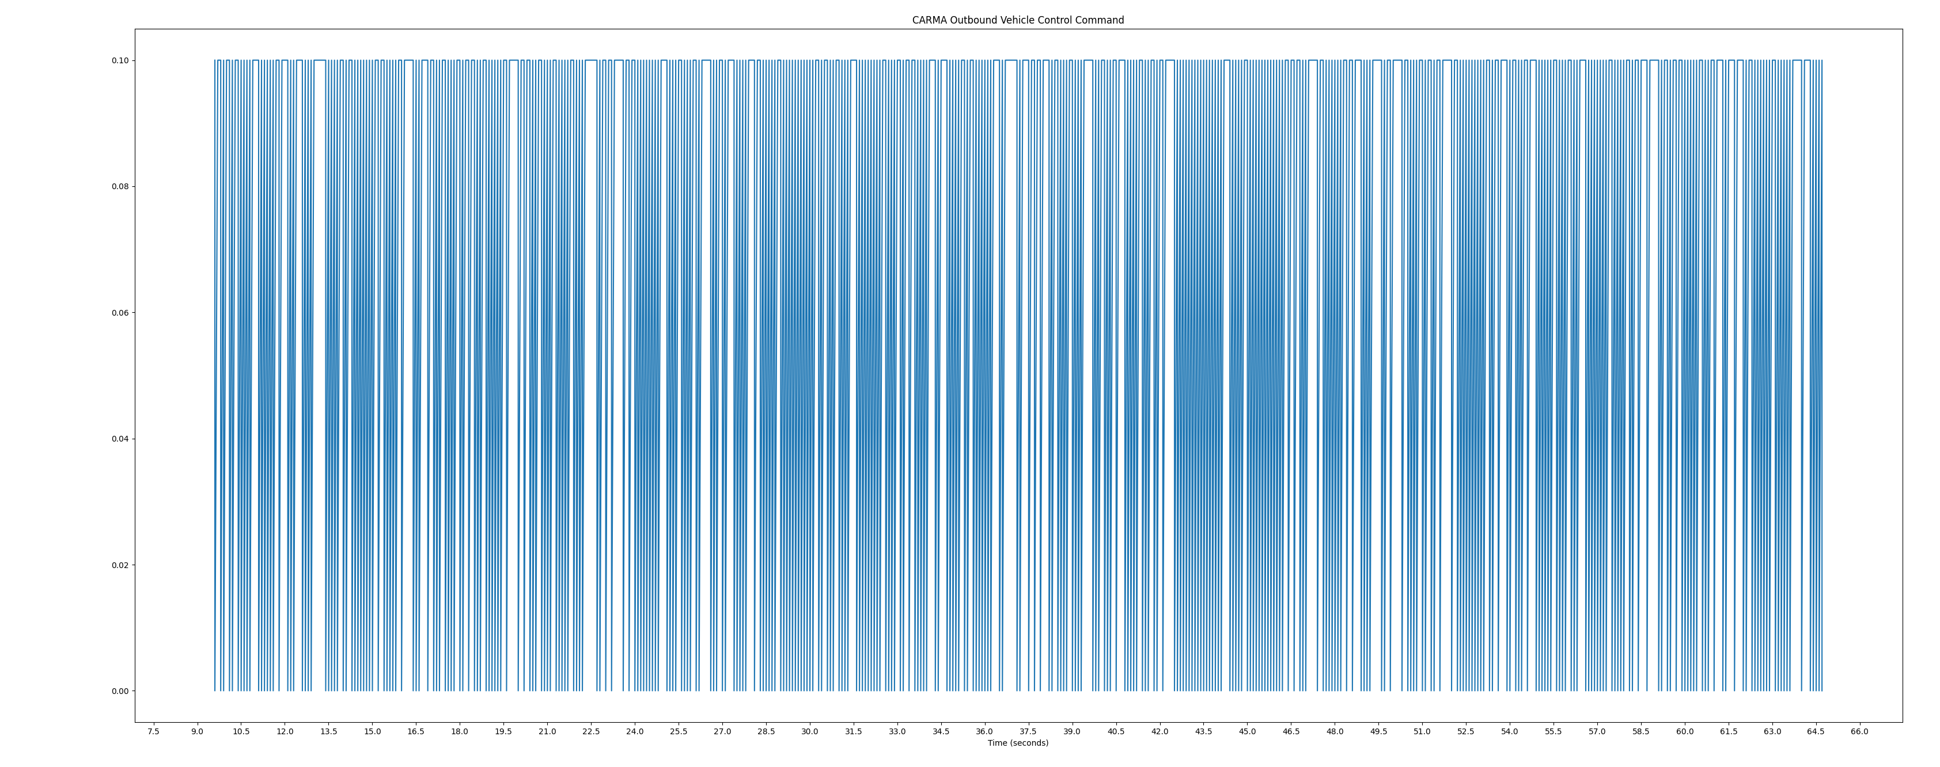
Support verification
Notes:
Cheng

Slide 17
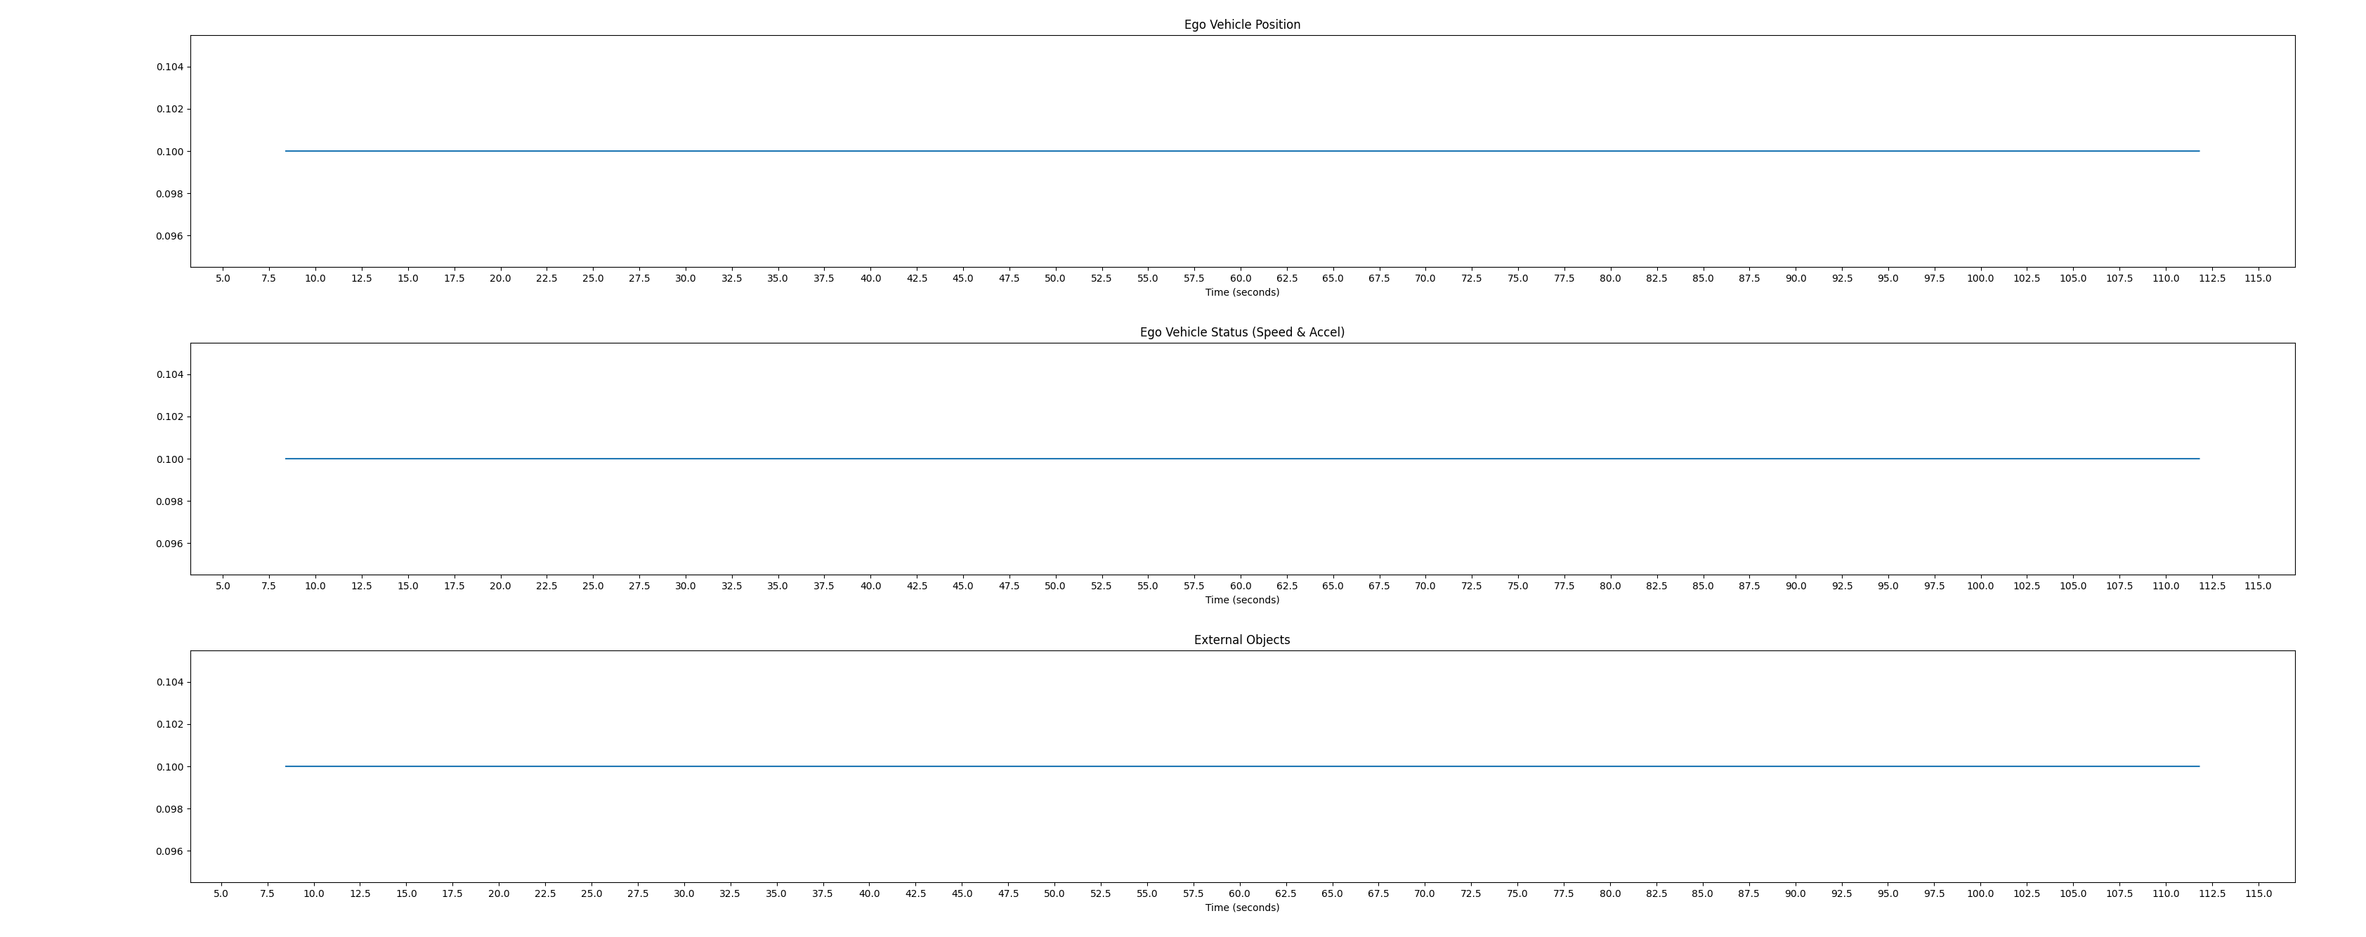
Support verification
Notes:
Cheng

Slide 18
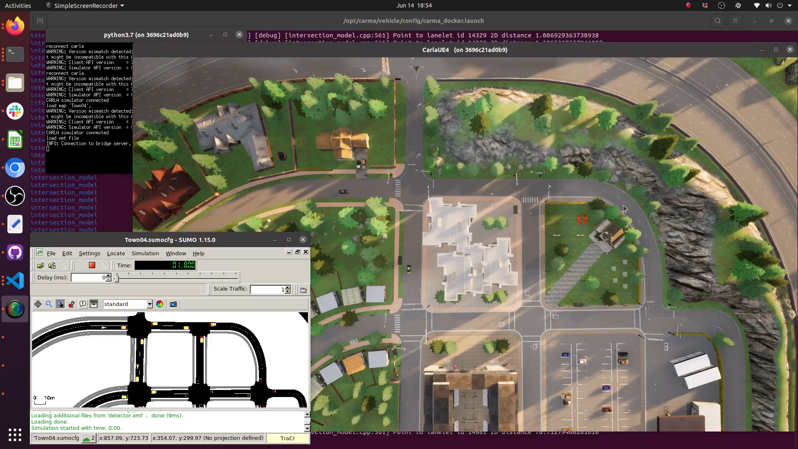
Support verification
Notes:
Cheng _> XiL-412

Slide 19
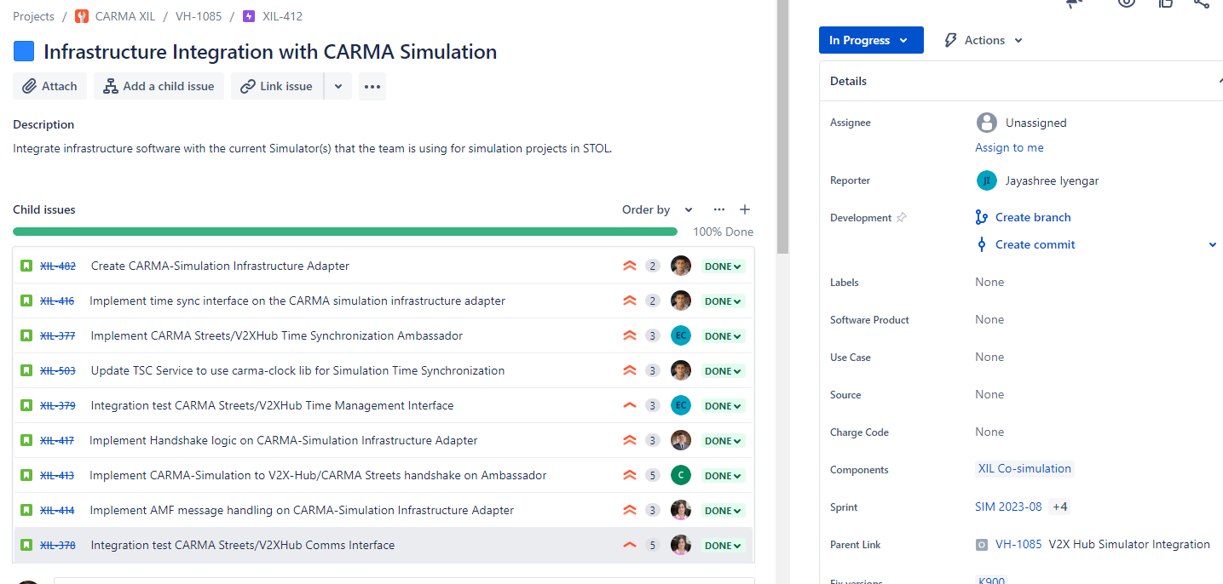
XiL-412: Infrastructure Integration with Carma Simulation
Epic that captures the Simulation/Streets Integration work is complete
Some Statistics: 34 Issues, 5 Sprints, 94 Story Points
Notes:
Integration -> HDSA

Slide 20
HDS Architecture

Slide 21
CHDA-54: HDS Design Capture
Notes:
Author -> Next Author

